Slide 1
MLCAS Corn Yield Prediction Using Satellite Data
Igor Kuivjogi Fernandes
Center for Agricultural Data Analytics (CADA)
Statistics and Analytics program
University of Arkansas
Notes:
Hello, everyone!
I am Igor Fernandes, a master's degree student at the University of Arkansas. Today, I am going to present my solution for this challenge.

Slide 2
Feature engineering step
1) For every pixel in every plot:
NDVI = (NIR – R) / (NIR + R) NDRE = (NIR - RE) / (NIR + RE)
Feature extraction
Do we need features from all TPs?
2) For every plot at different time points (TPs):
Mean, median, min, max, sum, Q1, and Q3
Aggregation
Location | Plot_id | Mean_NDVI_TP1 | Median_NDVI_TP2 | … | Median_NDVI_TP4 | Mean_NDRE_TP1 | Median_NDRE_TP2 | ... | Median_NDRE_TP4 | yield
Ames | 1 | 0.45 | 0.59 | … | 0.39 | 0.21 | 0.25 | … | 0.35 | 120
Ames | 2 | 0.43 | 0.57 | … | 0.37 | 0.23 | 0.29 | … | 0.38 | 123
… | … | … | … | … | … | … | … | … | … | …
Ames | N | 0.41 | 0.58 | … | 0.36 | 0.24 | 0.28 | … | 0.37 | 122
Lincoln | 1 | 0.57 | 0.62 | … | 0.61 | 0.31 | 0.35 | … | 0.42 | 135
Lincoln | 2 | 0.56 | 0.60 | … | 0.62 | 0.33 | 0.37 | … | 0.45 | 132
… | … | … | … | … | … | … | … | … | … | …
Lincoln | N | 0.59 | 0.65 | … | 0.70 | 0.37 | 0.40 | … | 0.48 | 140
… | … | … | … | … | … | … | … | … | ...
Notes:
Let's start with the feature engineering step.
First, I calculated two vegetation indices - NDVI and NDRE - for every pixel within each plot.
Then, I aggregated the features using summary statistics for every plot at the different time points.
The data will look like this, with features and the associated yield for each plot.
But...do we need to use the features from ALL TPs?
In this challenge, the answer is NO. Let's see why.

Slide 3
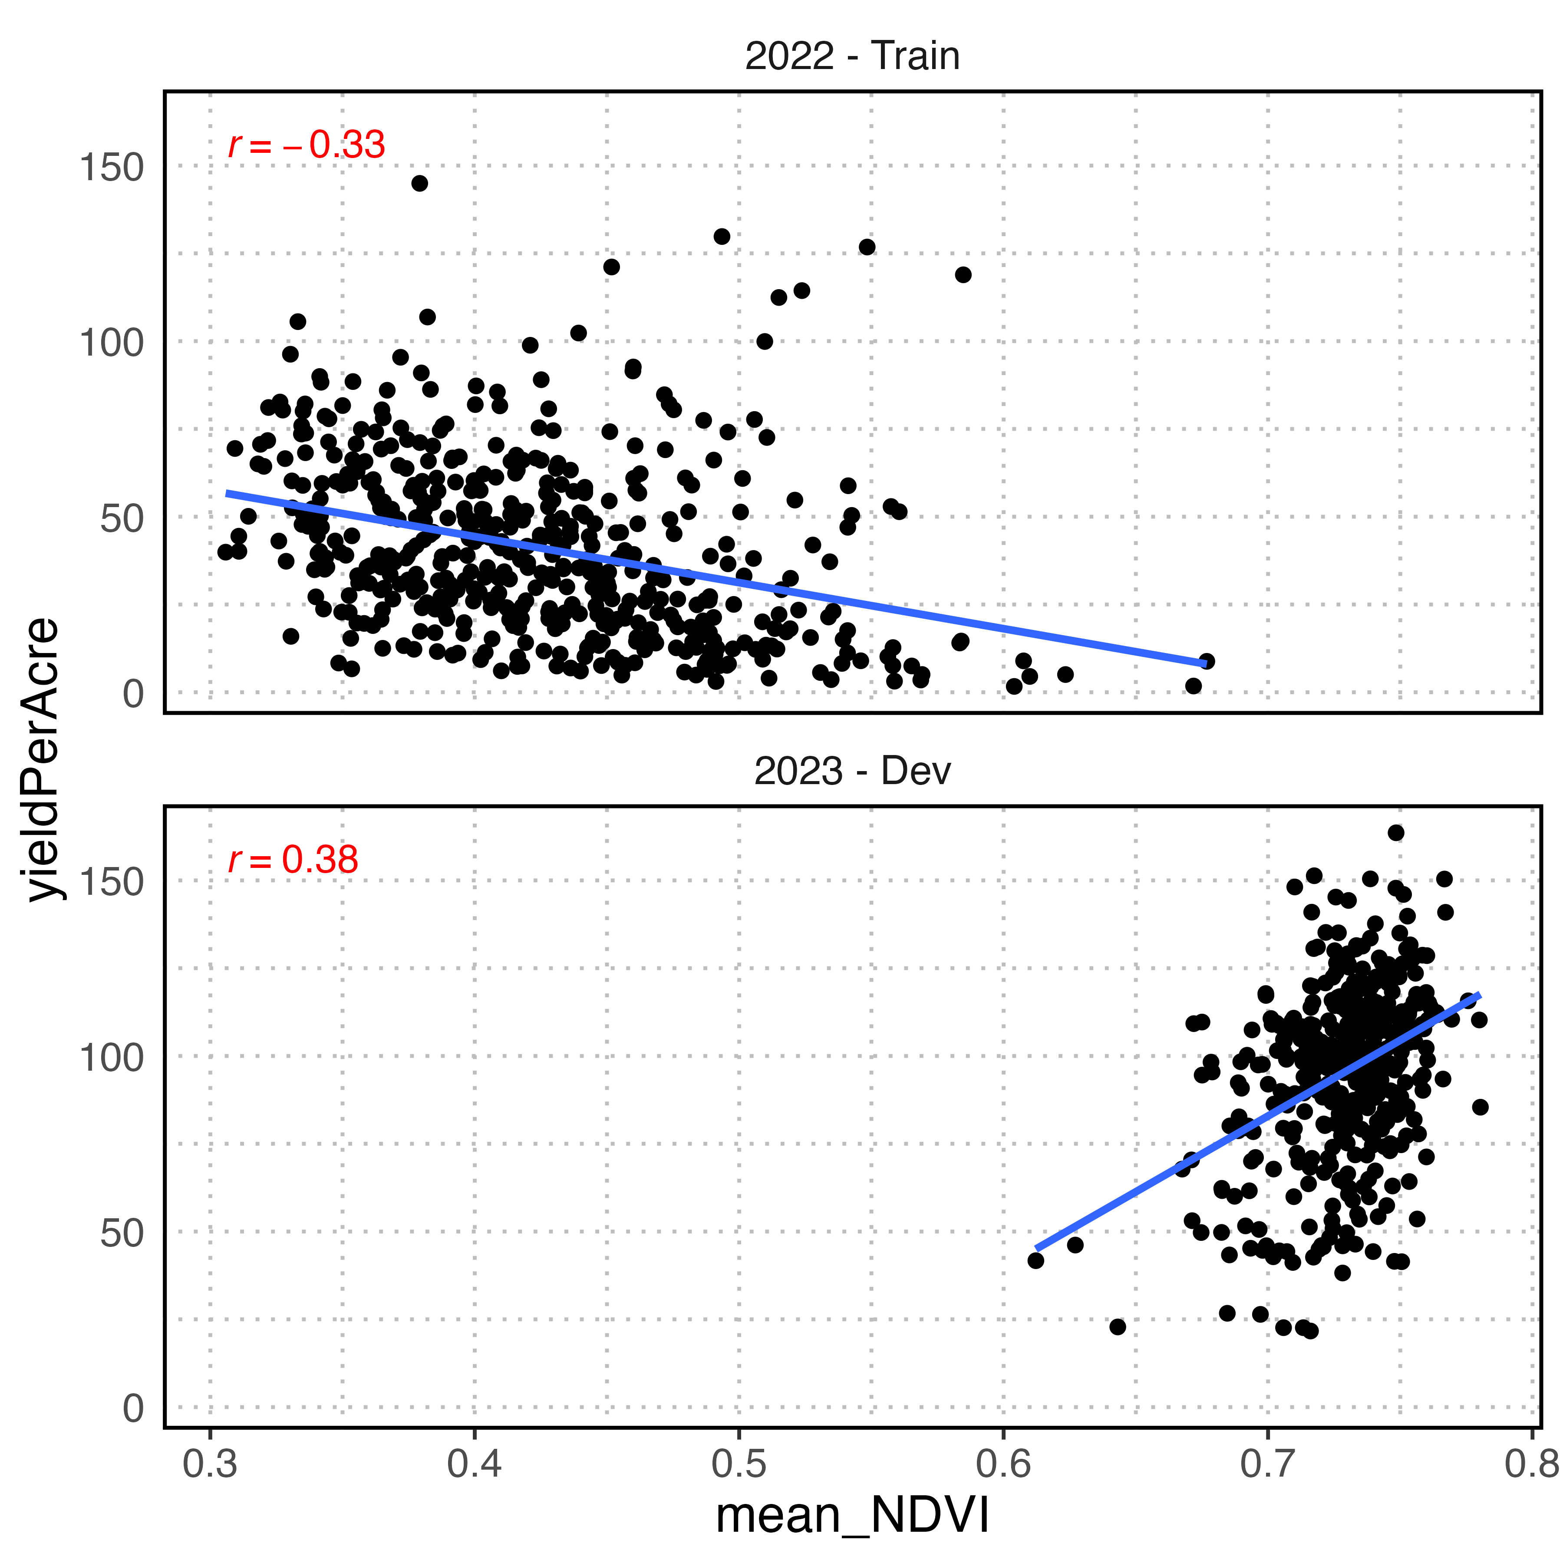
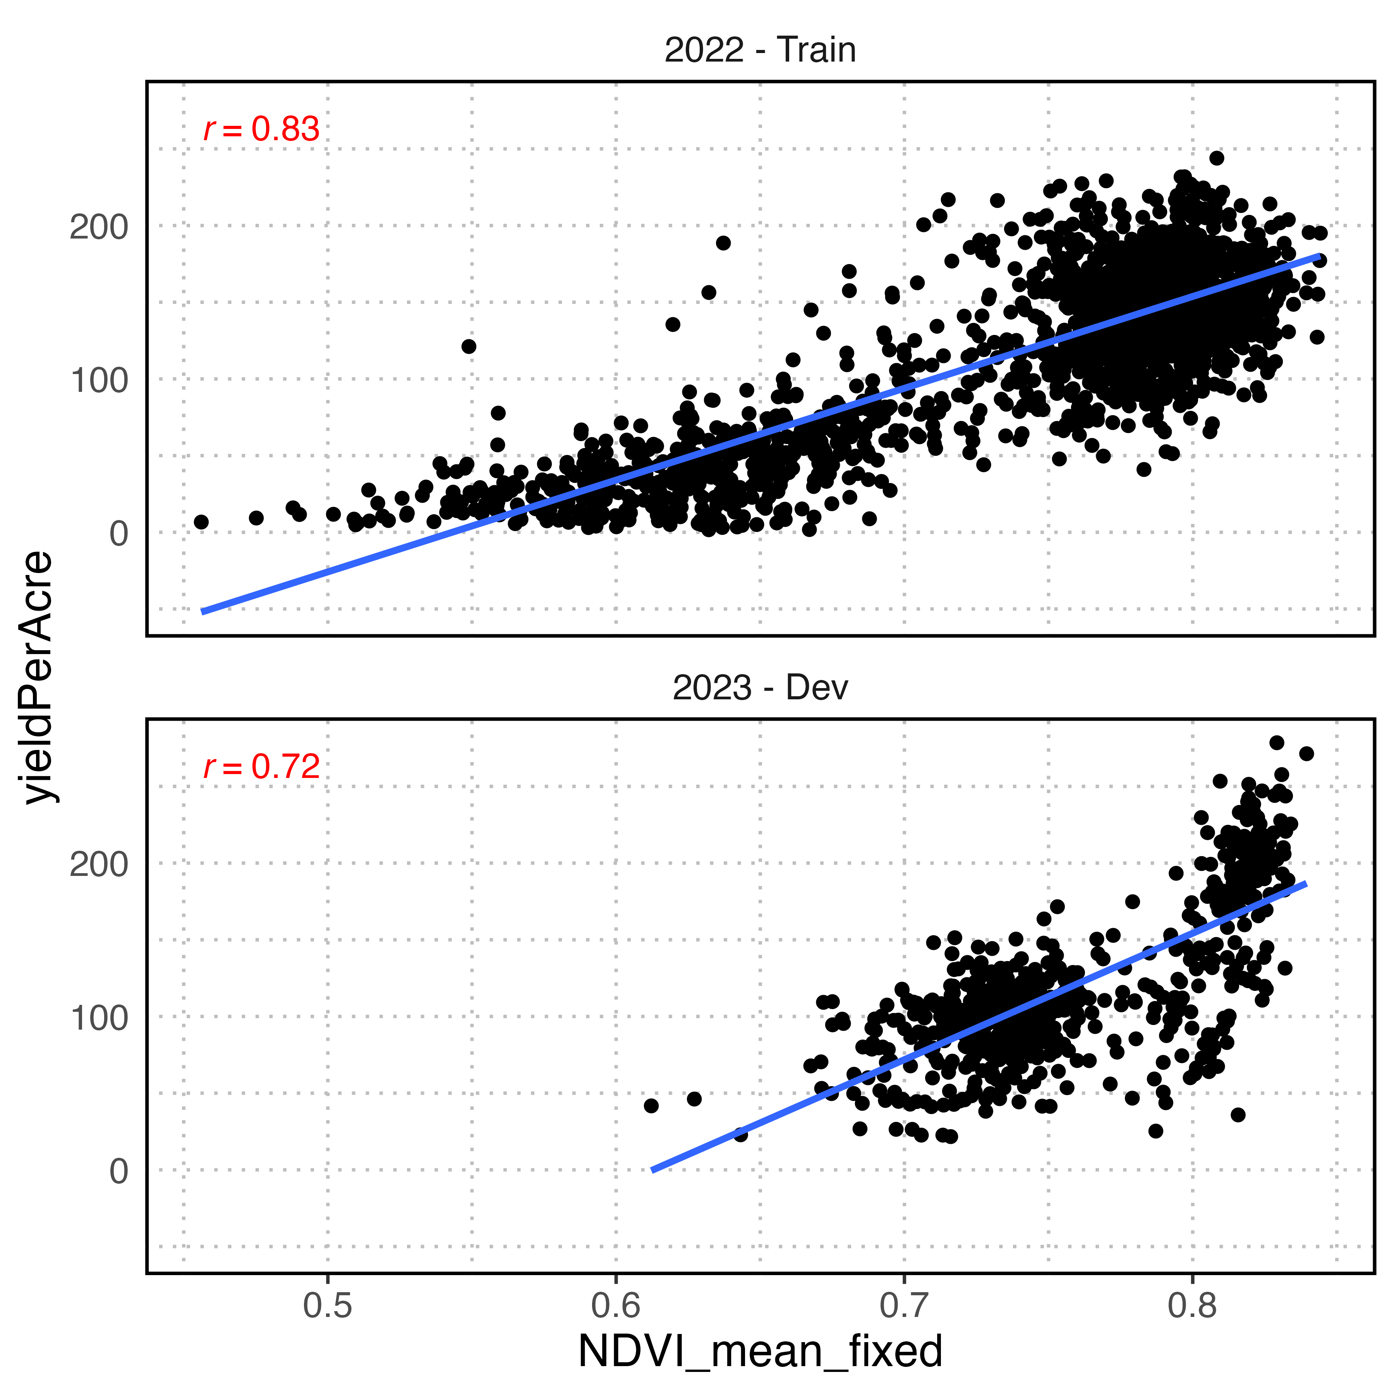
Variability among locations and TPs
TP3: 103 DAP
TP3: 88 DAP
Notes:
This plot shows the variability of Days After Planting (DAP) among locations and TPs.
If we use those TP3 features in our training set to train the model...
And those TP3 features to predict in the validation set...
We are comparing apples to oranges.
So, I cherry-picked TPs within a narrow range of DAPs across locations and years, hoping that plants would be in a similar development stage.
Now, we have a much stronger and consistent linear relationship between the features and the response across years.

Slide 4
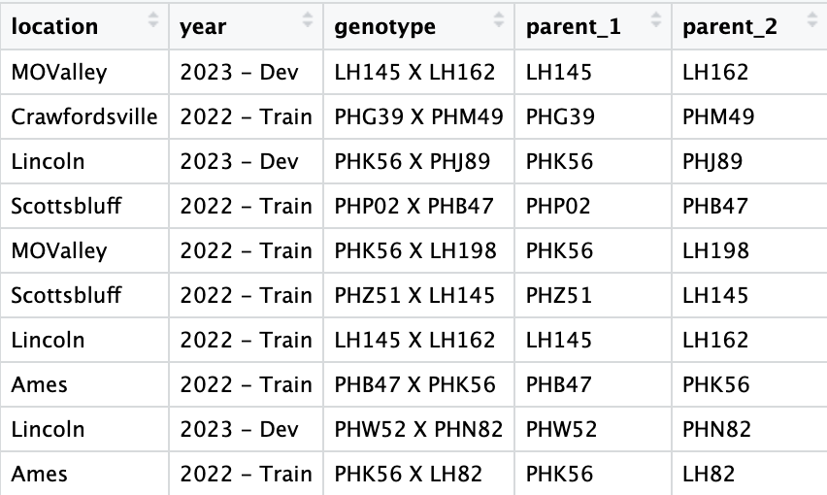
Linear Mixed Model
Y = Xβ + Z1u1 + Z2u2 + ε
Parent 1
Parent 2
VIs
Notes:
Finally, I fitted a linear mixed model where...
The chosen TP features were used as fixed effects
And the genotype was split into two random effects: parent 1 and parent 2.
This split was done because the parents are present at different crosses and different year-location combinations. In this way, we expect to explain some of this genetic variability.

Slide 5



Thank you!
Acknowledgments
Code
University of Arkansas
Fernandes LAB
Notes:
Thanks for the opportunity to showcase my solution.
Do you guys have any questions?

